Slide 1

Data Leadership: Navigating Security, Governance, and Ethical Decision-Making in the Digital Skies

Slide 2

Agenda
Introduction Security, Governance, and Ethics Data Security Challenges Data Governance Technology and Tools Case Studies Conclusion

Slide 3
Introduction
Security governance and ethics
Importance of security governance and ethical management
Data Security challenges
Data Governance fundamentals
Ethical decision making in data management
Technologies and Tools
Ethical case studies

Slide 4



About me
Gethyn Ellis
Microsoft, Azure, Power Platform Trainer
www.gethynellis.com
gethyn@gethynellis.com
Twitter: @gethyn_ellis
LinkedIn: https://www.linkedin.com/in/gethynellis/

Slide 5

Case Study Poll
I want you to rate the three cases studies

Slide 6

Security, Governance, and Ethics

Slide 7

Berry Wand – Chief Data Officer

Slide 8
Pillars of Trust in Modern Business
Security Governance
Ethical Management

Slide 9
Importance of Security Governance
Definition and Scope
Risk Management and Compliance
Incident Response and Resilience

Slide 10
Ethical Management Principles
Ethical Management: Conducting Business with Conscience
Data Ethics and Privacy
Corporate Social Responsibility (CSR)
Making Decisions with a Conscience
“Doing the right thing even, when nobody is watching”

Slide 11
Integrating Security and Ethics
A Holistic Approach for Modern Business
Enhancing Brand Reputation
Gaining a Competitive Advantage
Ensuring Long-term Sustainability

Slide 12

Data Security Challenges

Slide 13
Introduction to Data Security Challenges
The Importance of Data Security in the Digital Age
Data likened to new oil
A valuable asset
The fuel that powers AI
Increasing volume of data heightens security challenges.
Need for strategic measures to safeguard data.

Slide 14
The Evolving Landscape of Data Security Challenges
Key Challenges in Data Security
Rapid Technological Advancement
Sophistication of Cyber Attacks
Regulatory Compliance and Data Sovereignty
Insider Threats
Cloud Security

Slide 15
Overcoming Data Security Challenges
Strategic Approaches to Enhancing Data Security
Implementing a Zero Trust Architecture
Enhancing Cybersecurity Awareness and Training
Investing in Advanced Security Technologies
Regular Audits and Risk Assessments
Data Privacy and Protection by Design

Slide 16

Data Governance

Slide 17

Introduction to data governance
Introduction to Data Governance
The Fundamentals of Data Governance
A Pathway to Effective Management

Slide 18

The Core Principles of Data Governance
Core Principles of Effective Data Governance
Data Stewardship and Ownership
Data Quality
Data Security and Privacy

Slide 19
Ensuring Compliance and Promoting Transparency
Sustaining Governance: Compliance and Transparency
Data Lifecycle Management
Regulatory Compliance
Transparency and Accountability
Collaboration and Communication

Slide 20

Technology and Tools

Slide 21
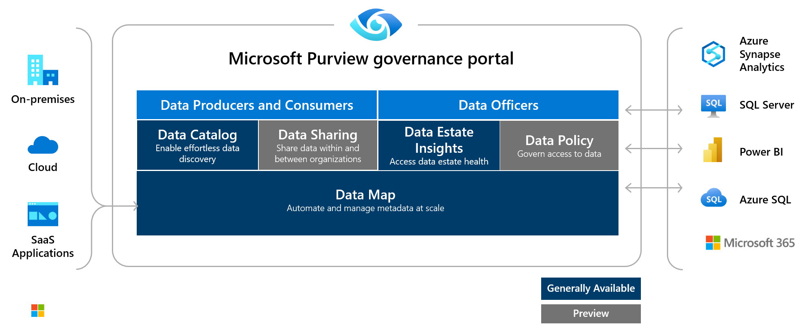
What is Purview

Slide 22
How Microsoft Purview Works
Register sources
Scan and classify
View Data Map
Search

Slide 23
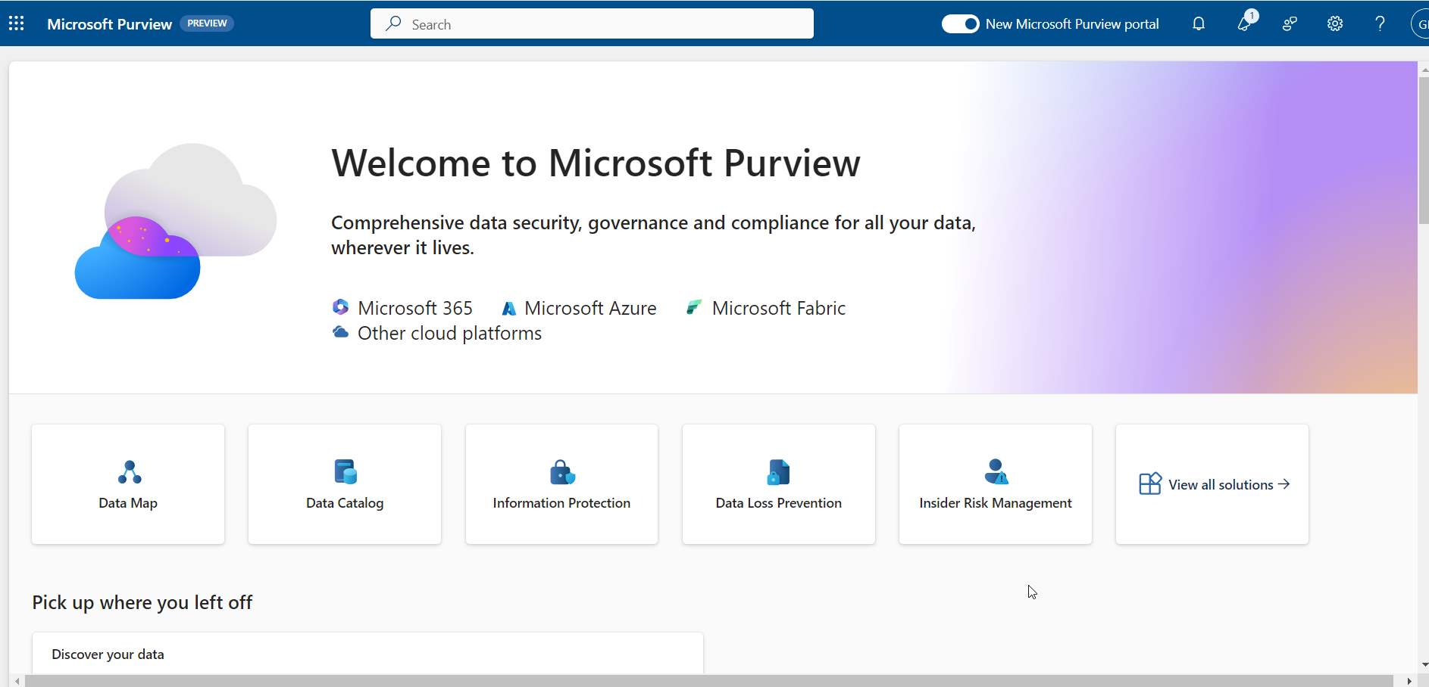

Slide 24
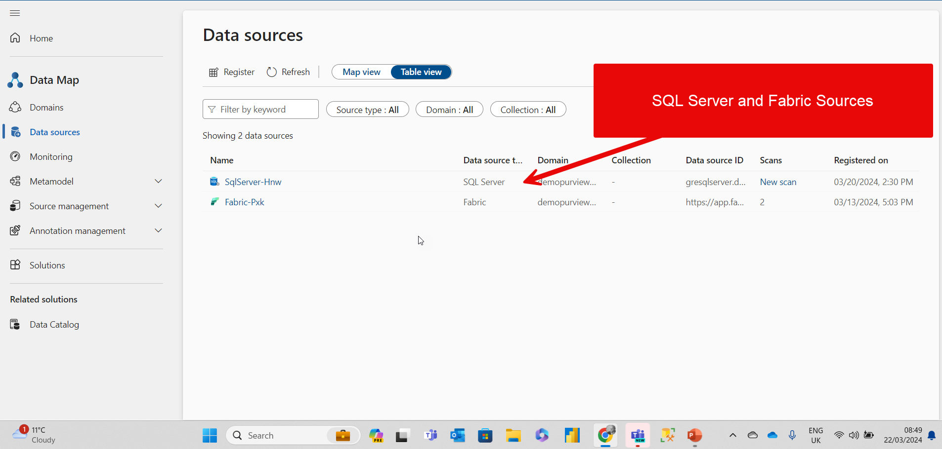

Slide 25
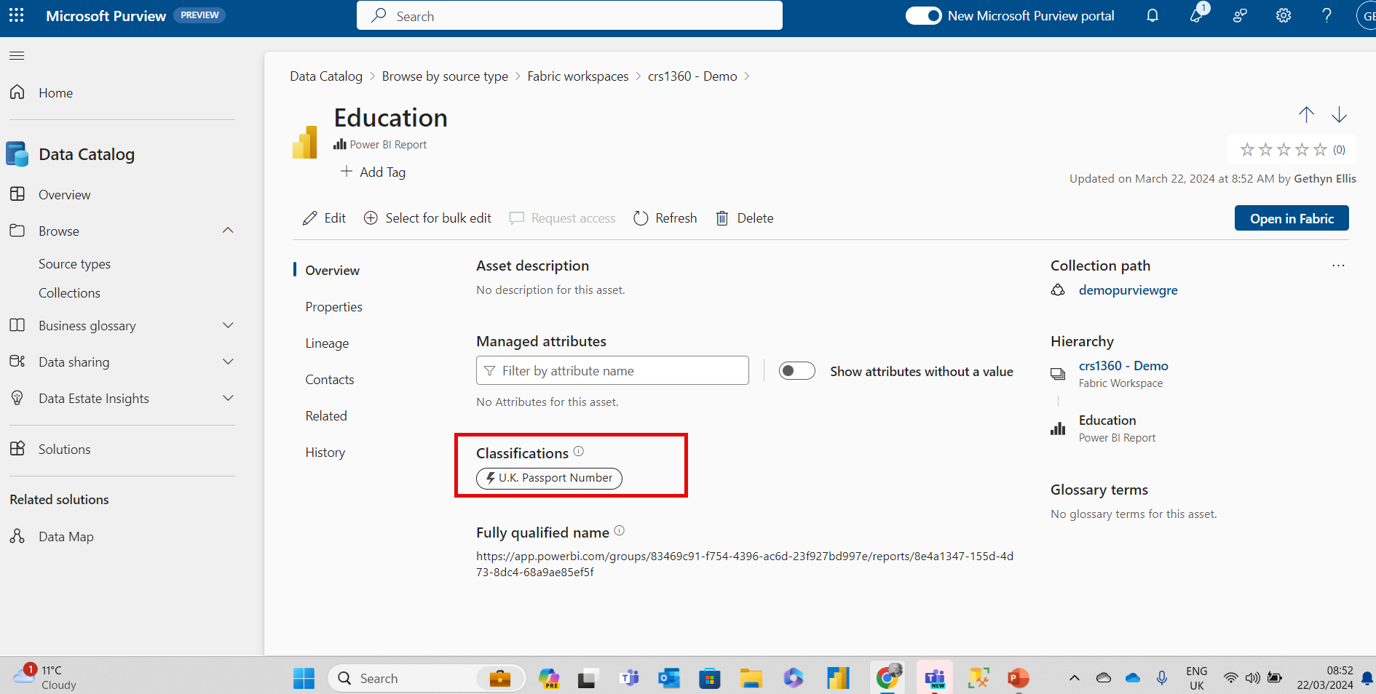
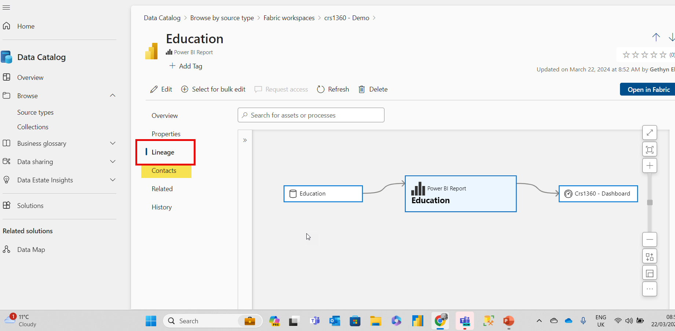
Data Catalog

Slide 26
Use cases
Discovery
If there’s no central location to register data sources, users might be unaware of a data source unless they come into contact with it as part of another process.
Governance
Compliance with company security policies, government regulations, and customer needs, are critical considerations for data governance.

Slide 27
Other technologies
Microsoft Defender
Microsoft Sentinel

Slide 28

Ethical Considerations in Data Handling and Management
Respecting individual autonomy beyond legal requirements: Privacy and Consent
Commitment to accuracy for well-being and fairness: Data Accuracy and Quality
Identifying and mitigating biases in data practices: Fairness and Non-Discrimination

Slide 29
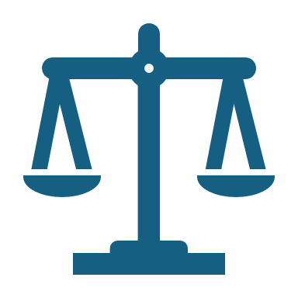
Ethical Considerations in Data Handling and Management

Slide 30
Ethical Considerations in Data Handling and Management
Privacy and Consent: Respecting individual autonomy beyond legal requirements.
Data Accuracy and Quality: Commitment to accuracy for well-being and fairness.
Fairness and Non-Discrimination: Identifying and mitigating biases in data practices.

Slide 31
Building Trust: Transparency and Accountability in Data Practices
Transparency: Being open about data collection, use, and sharing practices.
Accountability: Addressing issues promptly and responsibly when they arise.

Slide 32

Case Studies

Slide 33
Case Study Poll
I want you to rate the three cases studies

Slide 34
Case Study 1 Ensuring Data Accuracy in Criminal Records
Ensuring Data Accuracy in Criminal Records
Audit reveals inaccuracies in criminal records database.
Initiatives for improving data accuracy: verification software, routine data reviews, data literacy campaigns.
Significant improvement in public trust and reduction in wrongful arrests.

Slide 35
Case Study 2: Predictive Policing
Case Study 2: Balancing Privacy and Public Safety
Introduction of a predictive policing system.
Ethical review, transparent framework, and oversight mechanism implementation.
Success in deploying the system with community support.

Slide 36
Case Study 3 The Community Sentinel Initiative
Background:
Launched by Berry Wand.
Aims to use data to improve police-community relations.
Challenge:
Public perception of police was worsening.
Lack of engagement with community leaders.
Community sentiment data was underutilized.
Action:
Data-driven community outreach program developed.
Used data from community surveys, social sentiment analysis, and town halls.
Outcome:
Neighborhood watch programs created with data insights.
40% improvement in public trust.
Data collection model adopted by other cities.

Slide 37

Summary
The current landscape
Importance of security governance and ethical management
Understand the landscape
Security challenges
Governance fundamentals
Ethical decision making in data management
Leadership in Action
Building a Culture of Data Protection and Ethics
Challenges of data leadership
Strategies for data management
Technologies and Tools

Slide 38
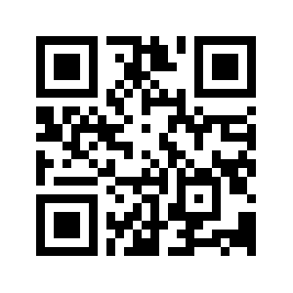
Please leave your feedback

